Slide 1
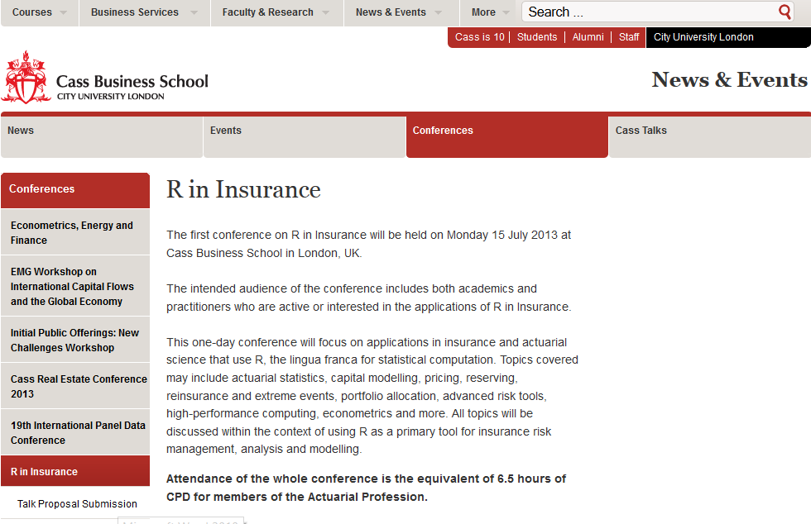
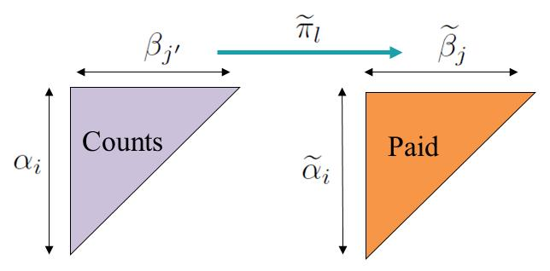

A new -package for statistical modelling and forecasting in non-life insurance
María Dolores Martínez-Miranda
Jens Perch Nielsen
Richard Verrall
Cass Business School London, 15 July 2013

Slide 2

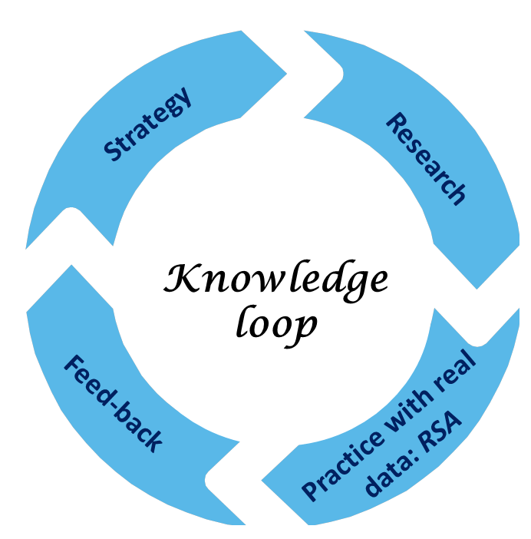


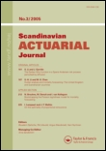

Background
2010 Including Count Data in Claims Reserving
2011 Cash flow simulation for a model of outstanding liabilities based on claim amounts and claim numbers
2012 Double Chain Ladder
2012 Statistical modelling and
forecasting in Non-life insurance
2013 Double Chain Ladder and
Bornhuetter-Ferguson
2013 Double Chain Ladder, Claims Development Inflation and Zero Claims
2013 Continuous Chain Ladder
Our aim: a package implementing recent research developments

Slide 3
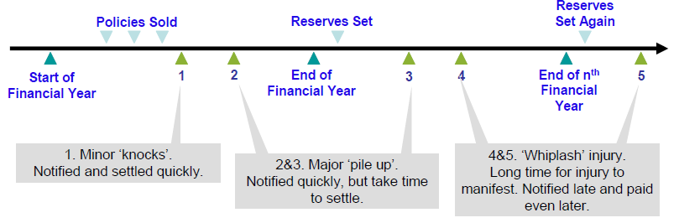
The problem: the claims reserving exercise
Claims are first notified and later settled - reporting and settlement delays exist.
Outstanding liability for claims events that have already happened and for claims that have not yet been fully settled.
The objectives:
How large future claims payments are likely to be.
The timing of future claim payments.
The distribution of possible outcomes: future cash-flows.

Slide 4
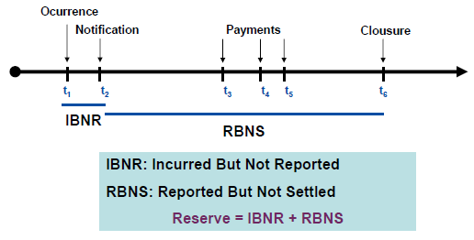
Framework: Double Chain Ladder
What is Double Chain Ladder?
A firm statistical model which breaks down the chain ladder estimates into individual components.
What is required? It works on run-off triangles (adding expert knowledge if available).
Why?
Connection with classical reserving (tacit knowledge)
Intrinsic tail estimation
RBNS and IBNR claims
The distribution: full cash-flow

Slide 5
The modelled data: two run-off triangles
D E V E L O P M E N T
We model annual/quarterly run-off triangles:
Incremental aggregated payments (paid triangle).
Incremental aggregated counts data, which is assumed to have fully run off.
A
C
C
I
D
E
N
T
R E P O R T I N G
A
C
C
I
D
E
N
T
Notes:
1. Periodic data triangle, which can be considered annually or quarterly
5

Slide 6
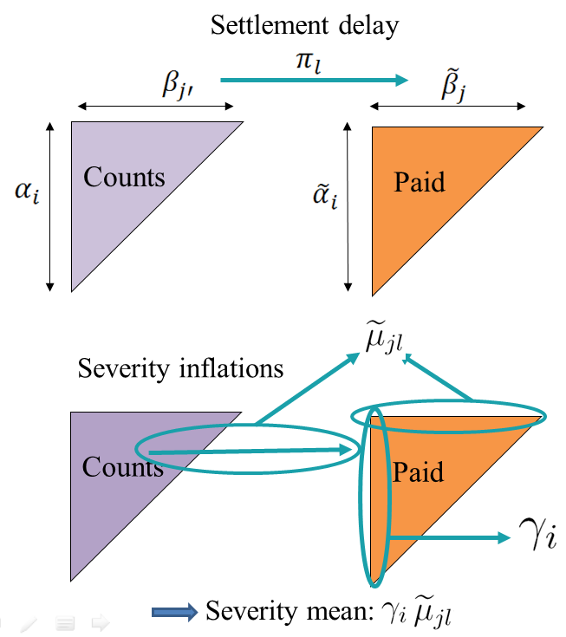





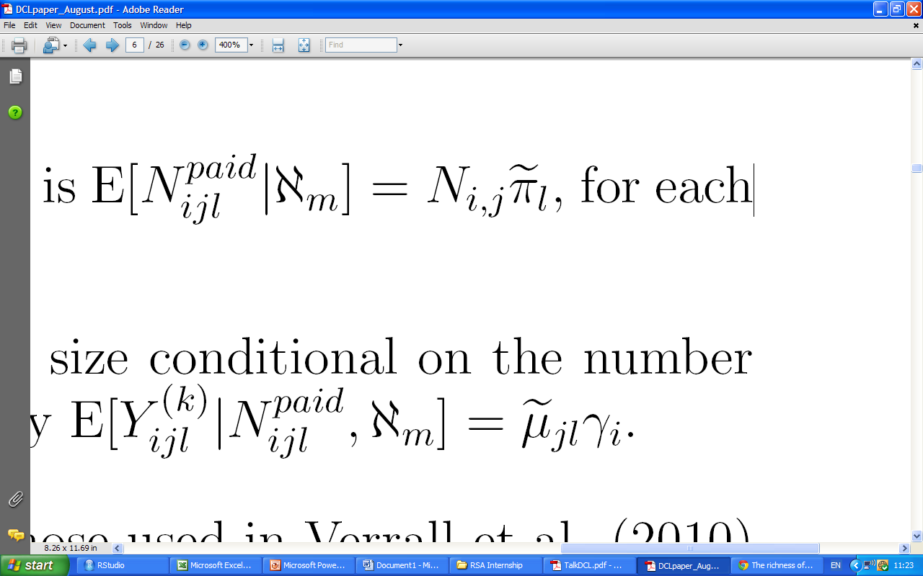
The Double Chain Ladder Model
Parameters involved in the model:
Ultimate claim numbers:
Reporting delay:
Settlement delay:
Development delay:
Ultimate payment numbers:
Severity:
underwriting inflation:
delay mean dependencies:

Slide 7
Implementing Double Chain Ladder
The kernel: calibrating the model
Data
Best estimate (RBNS/IBNR)
Full cash-flow
(RBNS/IBNR)
Expert knowledge

Slide 8
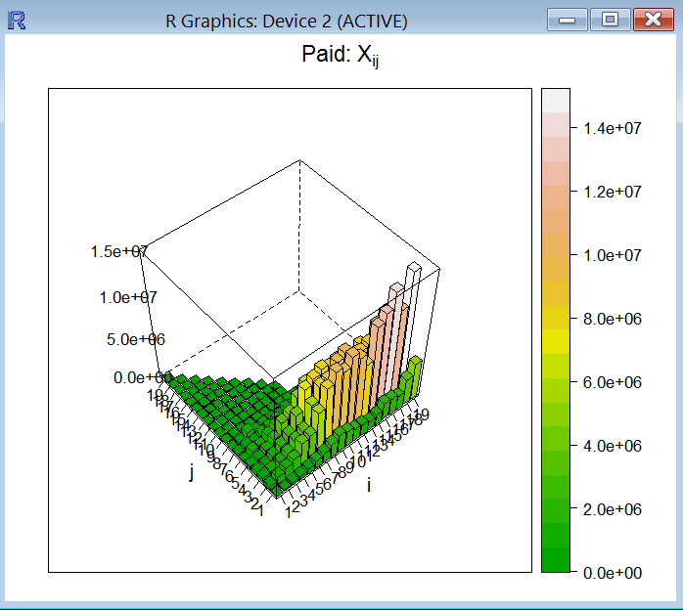
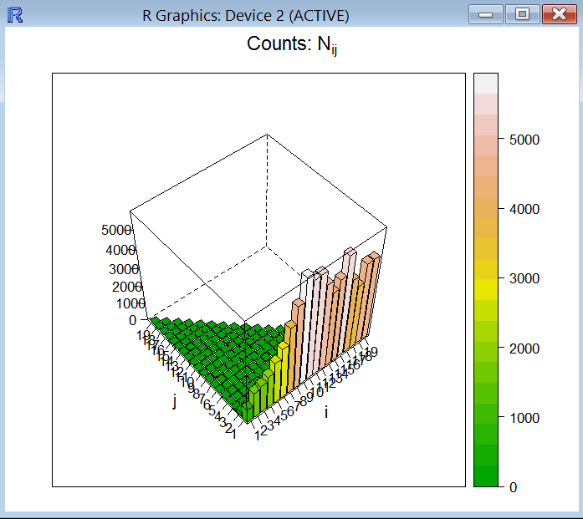
Visualizing the data: the histogram
D E V E L O P M E N T
A
C
C
I
D
E
N
T
R E P O R T I N G
A
C
C
I
D
E
N
T
Notes:
1. Periodic data triangle, which can be considered annually or quarterly
8

Slide 9
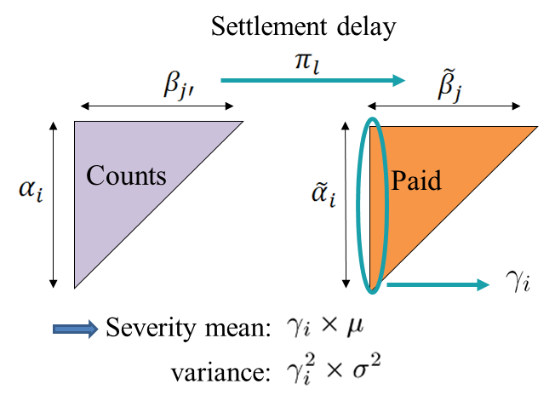


The kernel: calibrating the model
The available information could make a model infeasible in practice.
From two run-off triangles, the Double Chain Ladder Method estimate a model such as:
severity mean:
severity variance:
Classical chain ladder technique is applied twice to give everything needed to estimate.

Slide 10
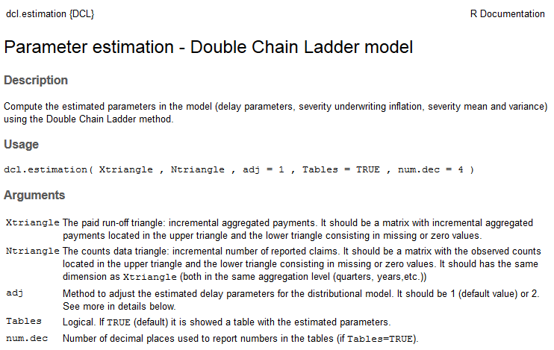
The kernel: parameter estimation using DCL
The function dcl.estimation()

Slide 11
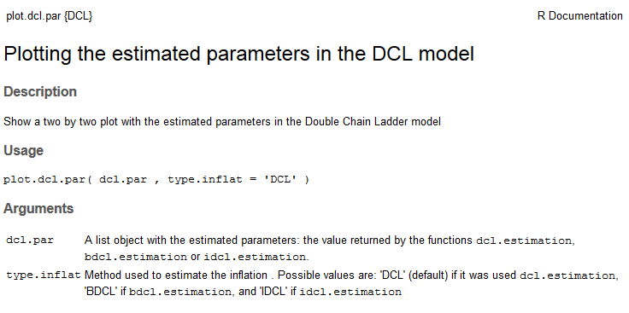
The kernel: parameter estimation using DCL
The function plot.dcl.par() to visualize the break down of the classical chain ladder parameters

Slide 12
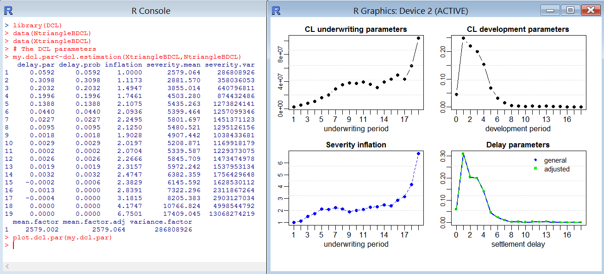
The functions in action: an example
Parameter estimates in two cases: the basic DCL model (only mean specifications) and the distributional model.

Slide 13
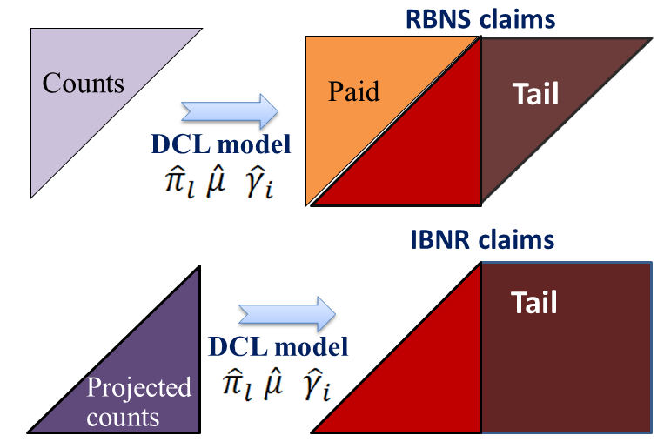
The best estimate: RBNS/IBNR split

Slide 14

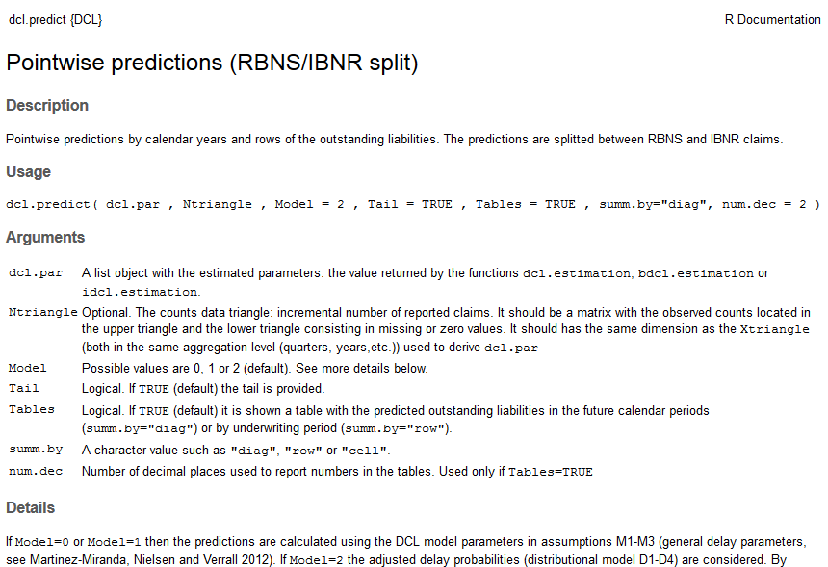
The best estimate: RBNS/IBNR split using DCL
The function dcl.predict()

Slide 15
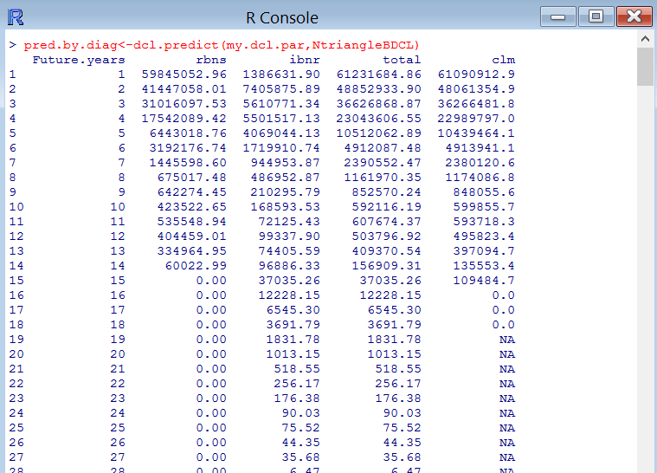
The function in action: an example
Summary by diagonals (future calendar years), rows (underwriting) and the individual cell predictions

Slide 16
The full cash-flow: Bootstrapping RBNS/IBNR
The simplest DCL distributional model assumes that the mean and the variance of the individual payments (severity) only depends on the underwriting period.
The following statistical distributions are assumed for each of the components in the model:
Component | Distribution
Count data | Poisson
RBNS delay | Multinomial
Severity | Gamma

Slide 17
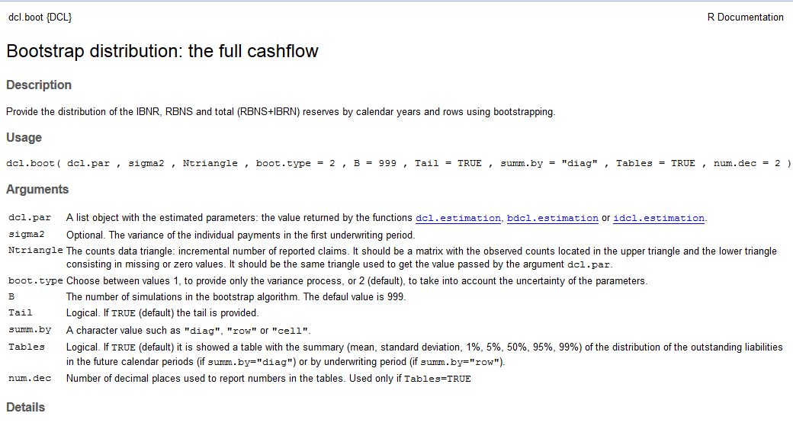
The full cash-flow: Bootstrapping using DCL
The function dcl.boot()
The function plot.cashflow()

Slide 18
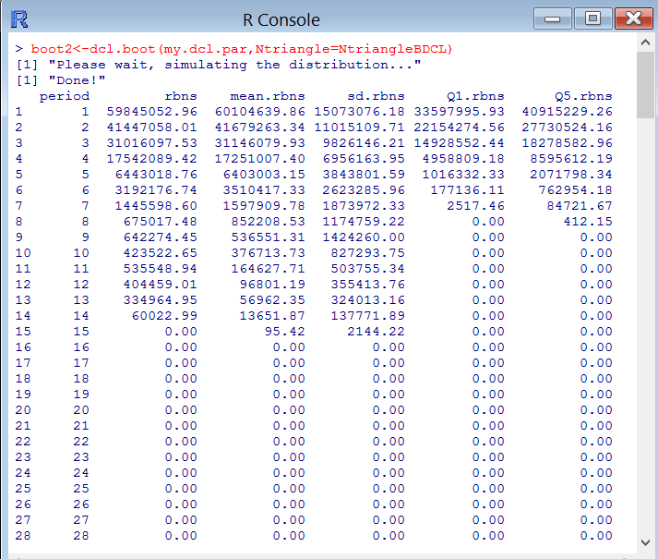
The functions in action: an example
A table showing a summary of the distribution: mean, std. deviation, quantiles.
Arrays and matrices with the full simulated distributions

Slide 19
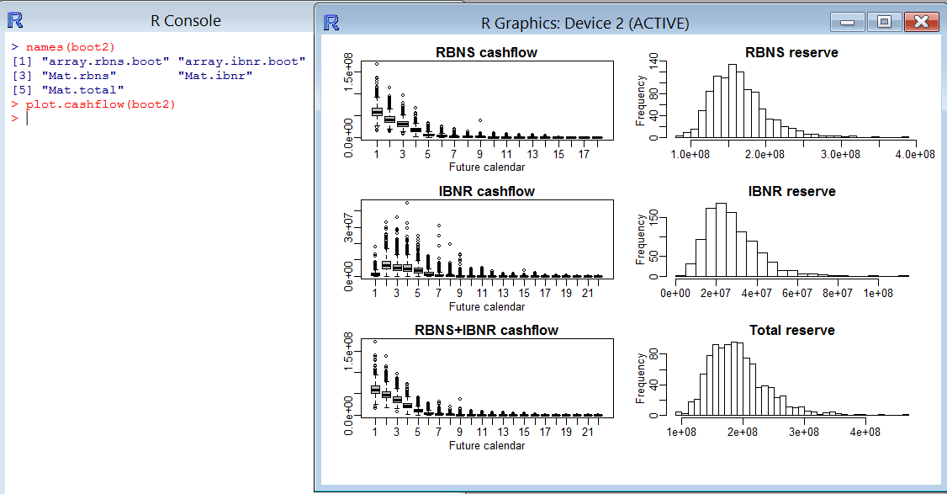
The functions in action: an example

Slide 20
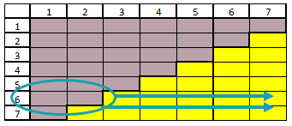
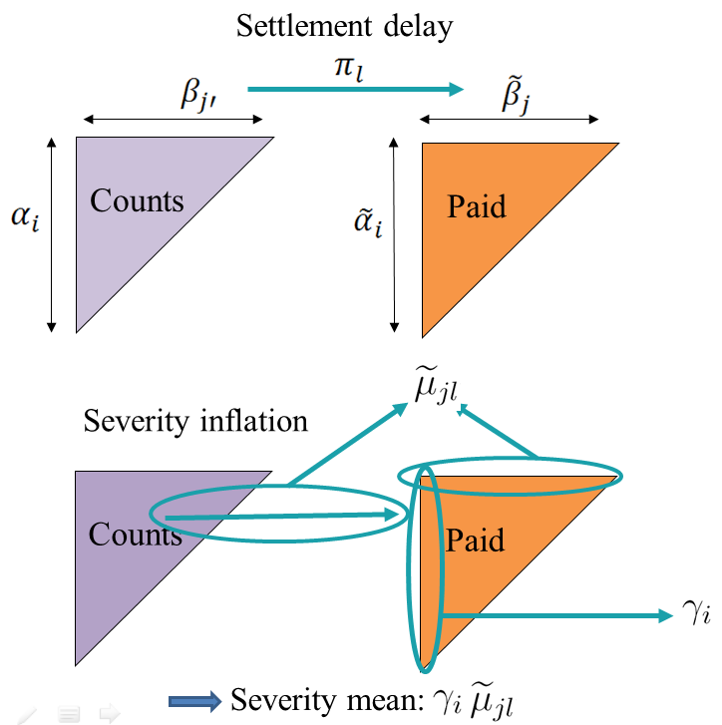
Moving from the (paid) chain ladder mean
Prior knowledge, when it is available, can be incorporated to:
Provide more realistic and stable predictions: Bornhuetter-Ferguson technique and the incurred data
Consider in practice more general models: development severity inflation, zero-claims etc.

Slide 21
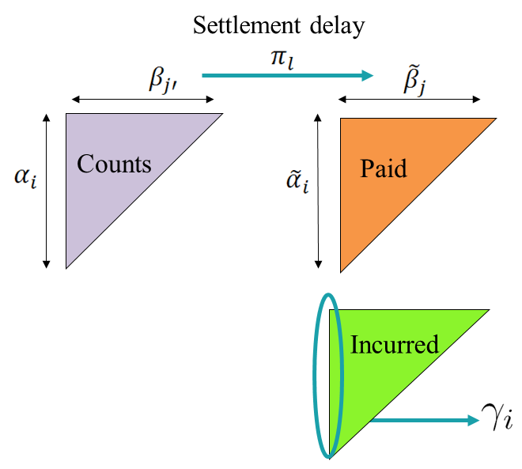
Using incurred data through BDCL and IDCL
The BDCL method takes a more realistic estimation of the inflation parameter from the incurred triangle
The IDCL method makes a correction in the underwriting inflation to reproduce the incurred chain ladder reserve
Summary: BDCL and IDCL operate on 3 triangles and give a different reserve than the paid chain ladder. Both provide the full cash-flow (RBNS/IBNR)

Slide 22

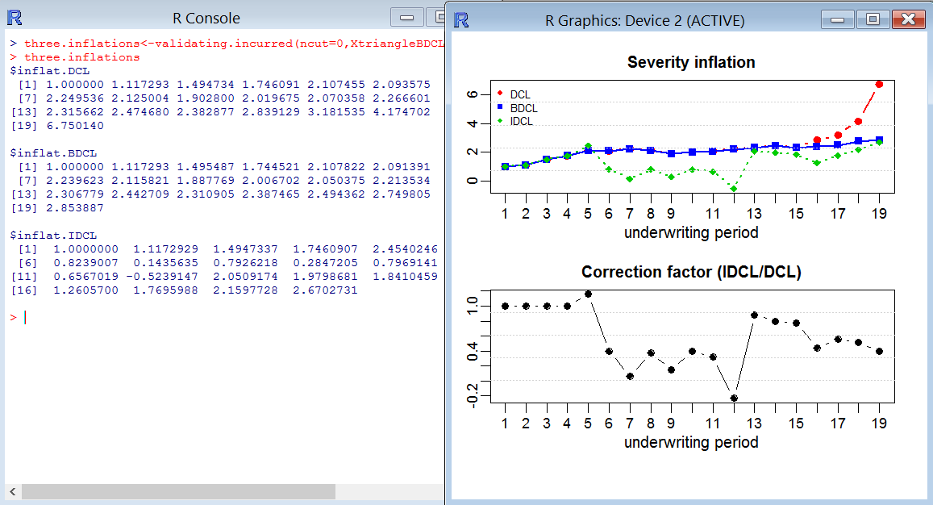
BDCL and IDCL in the package
Functions bdcl.estimation() idcl.estimation()
Validation strategy: validating.incurred()

Slide 23

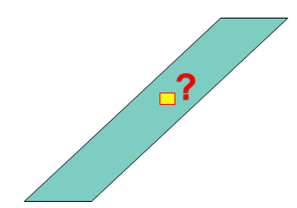


Validation
Testing results against experience:
Cut c=1,2,…,5 diagonals (periods) from the observed triangle.
Apply the estimation methods.
Compare forecasts and actual values.
Three objectives:
Predictions of the individual cells
Predictions by calendar years
The prediction of the overall total

Slide 24
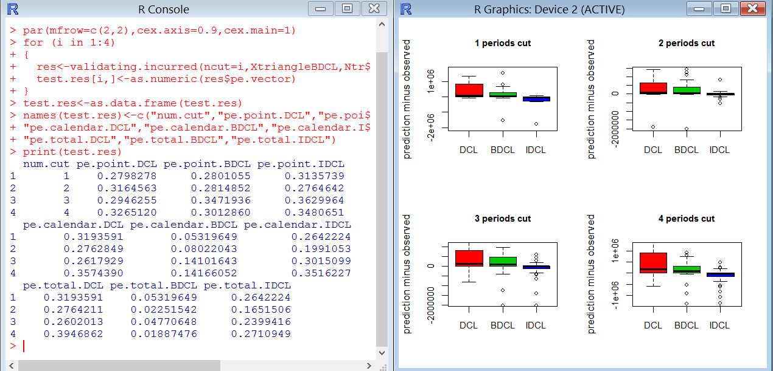
Validation strategy: validating.incurred()

Slide 25

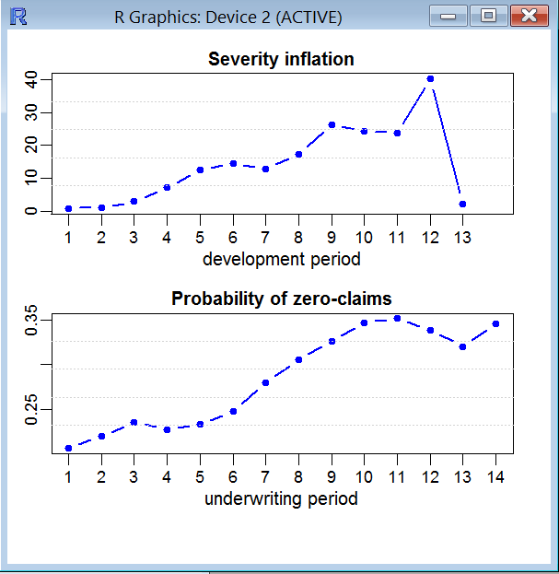
Working in practice with a more general model
Information about: development severity inflation, zero-claims etc. can be incorporated through DCL in a straightforward and coherent way.
The package provides the functions:
dcl.predict.prior()
dcl.boot.prior()
extract.prior()

Slide 26
Summary: the content of the package
8 run-off triangles
plot.triangle
Aggregate,get.incremental, get.cumulative
The kernel: calibrating the model
Data
Best estimate (RBNS/IBNR)
Full cash-flow
(RBNS/IBNR)
Expert knowledge
dcl.estimation
bdcl.estimation
idcl.estimation
plot.dcl.par
clm
plot.clm.par
extract.prior
Validation
dcl.predict
dcl.predict.prior
validating.incurred
dcl.boot
dcl.boot.prior
plot.cashflow

Slide 27
What next?
We look for a wide audience (academics, practitioners, students).
Your feedback is very valuable…
Submitting to the CRAN…
Variations and extensions are expected to come soon from the knowledge loop…
It is just the first version…

Slide 28
Appendix A: code -examples in this presentation
library(DCL)
data(NtriangleBDCL)
data(XtriangleBDCL)
# Plotting the data
plot.triangle(NtriangleBDCL,Histogram=TRUE,tit=expression(paste('Counts: ',N[ij]))
plot.triangle(XtriangleBDCL,Histogram=TRUE,tit=expression(paste('Paid: ',X[ij])))
# The kernel: parameter estimation
my.dcl.par<-dcl.estimation(XtriangleBDCL,NtriangleBDCL)
plot.dcl.par(my.dcl.par)
# The best estimate (RBNS/IBNR split)
pred.by.diag<-dcl.predict(my.dcl.par,NtriangleBDCL)
# Full cashflow considering the tail (only the variance process)
boot2<-dcl.boot(my.dcl.par,Ntriangle=NtriangleBDCL)
plot.cashflow(boot2)
## Compare the three methods to be validated (three different inflations)
data(ItriangleBDCL)
validating.incurred(ncut=0,XtriangleBDCL,NtriangleBDCL,ItriangleBDCL)
test.res<-matrix(NA,4,10)
par(mfrow=c(2,2),cex.axis=0.9,cex.main=1)
for (i in 1:4)
{
res<-validating.incurred(ncut=i,XtriangleBDCL,NtriangleBDCL,ItriangleBDCL,Tables=FALSE)
test.res[i,]<-as.numeric(res$pe.vector)
}
test.res<-as.data.frame(test.res)
names(test.res)<-c("num.cut","pe.point.DCL","pe.point.BDCL","pe.point.IDCL",
"pe.calendar.DCL","pe.calendar.BDCL","pe.calendar.IDCL",
"pe.total.DCL","pe.total.BDCL","pe.total.IDCL")
print(test.res)
# Extracting information about severity inflation and zero claims
data(NtrianglePrior);data(NpaidPrior);data(XtrianglePrior)
extract.prior(XtrianglePrior,NpaidPrior,NtrianglePrior)

Slide 29
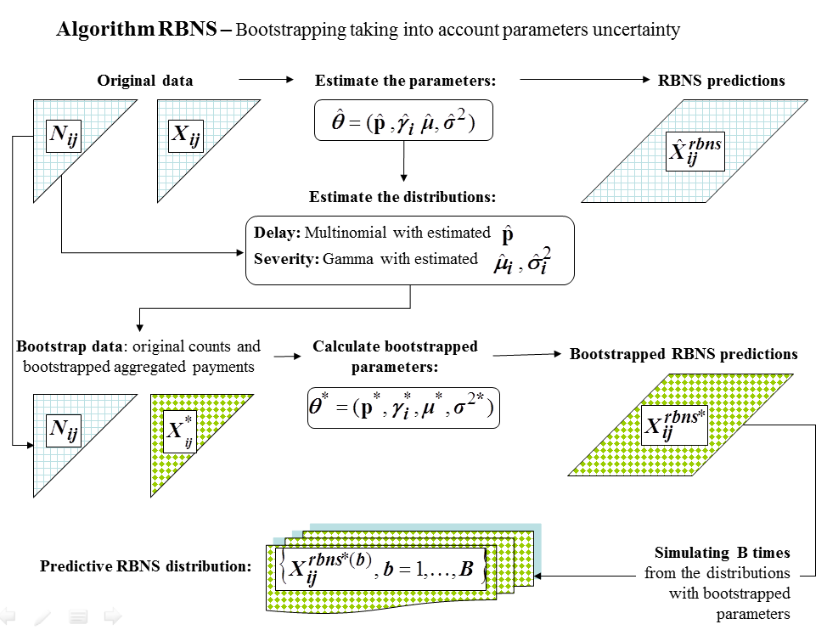
Appendix B: Bootstrap methods

Slide 30
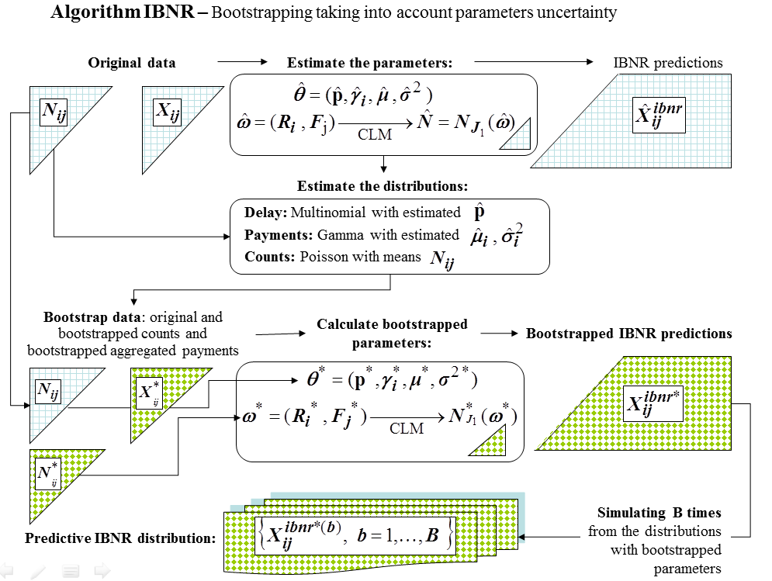
Appendix B: Bootstrap methods

